Slide 1
Course Overview
STP ICT 2025
Jayavant Shimpi

Slide 2
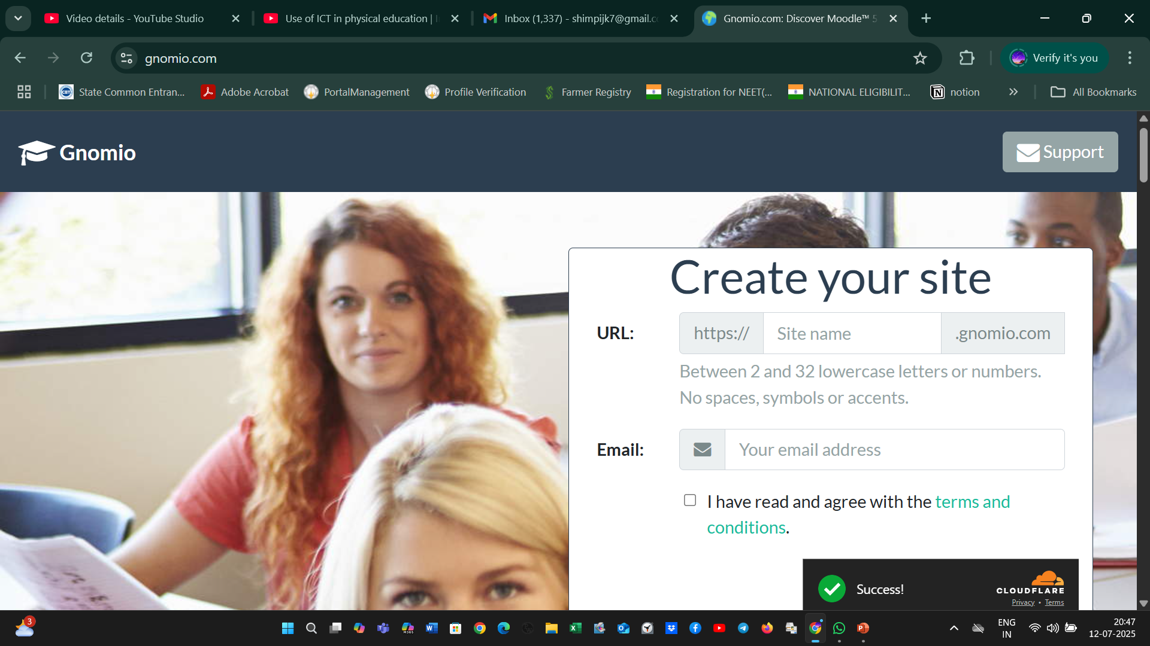
GNOMIO MOODLE COURSE CREATED

Slide 3
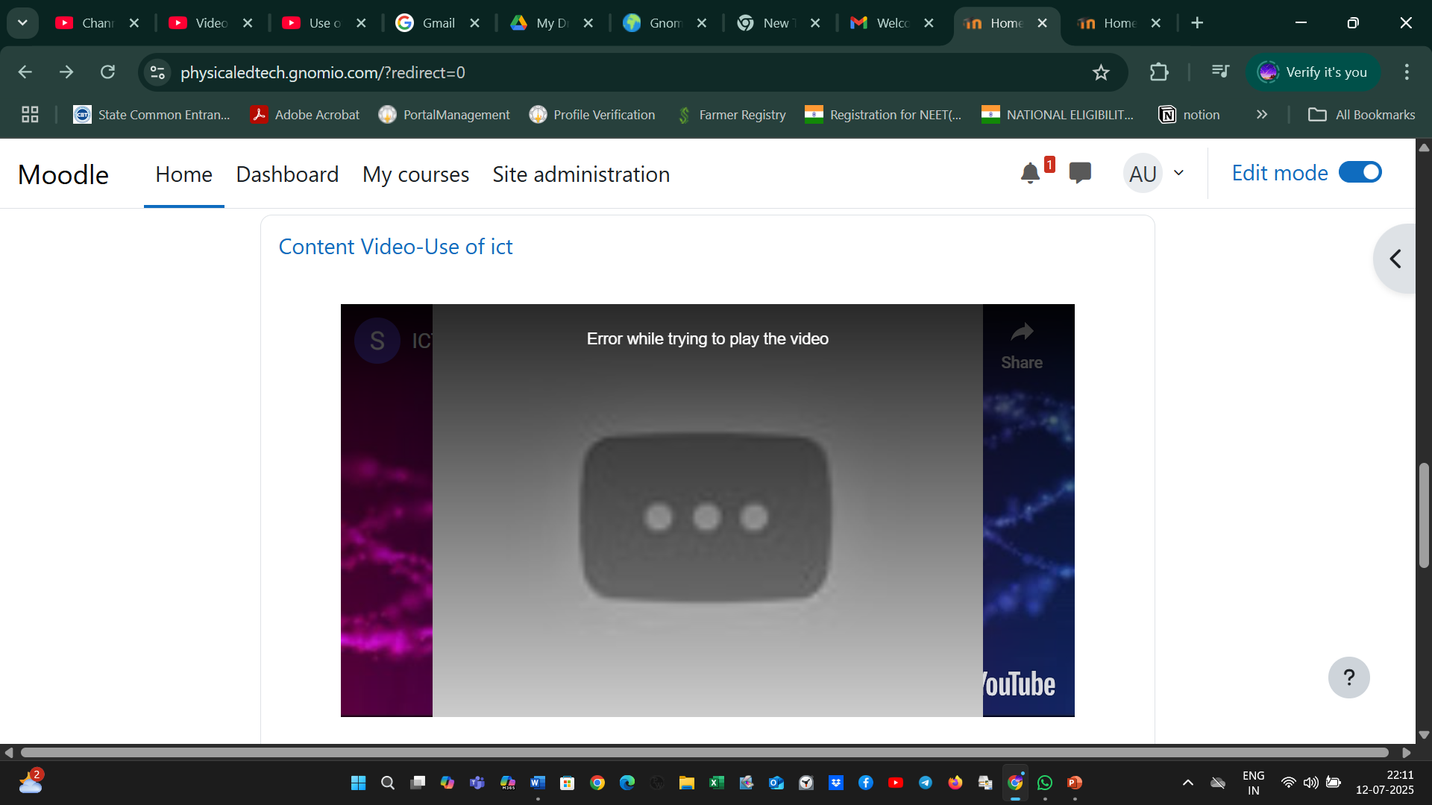
MODULE 1 WITH uploaded content

Slide 4
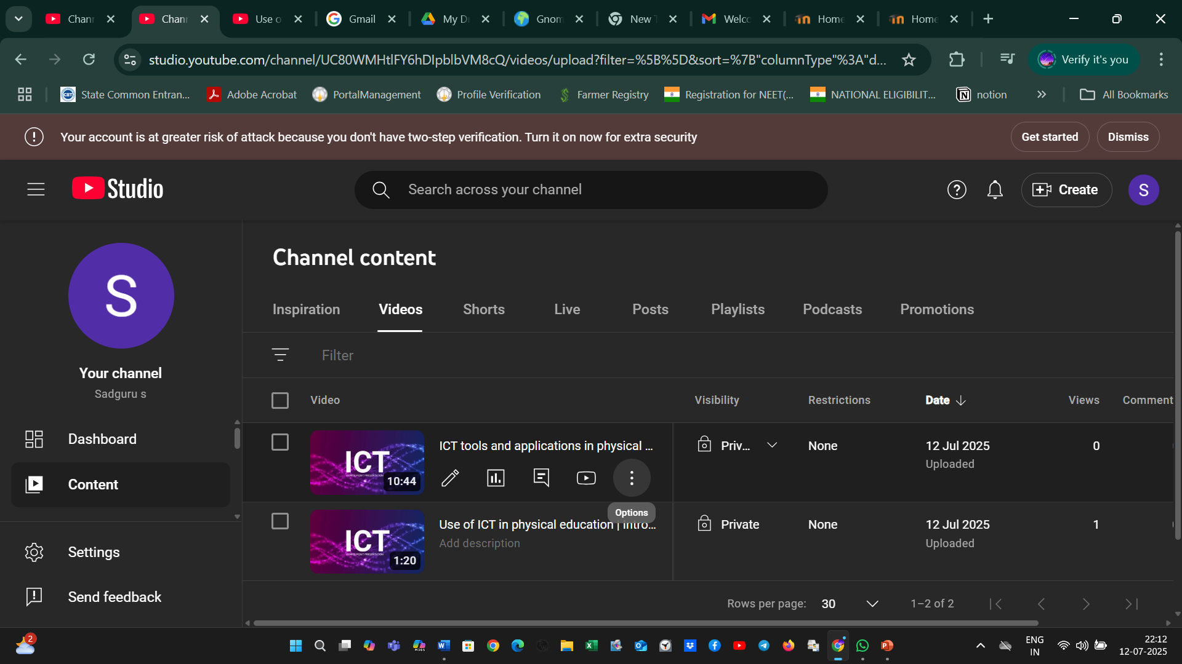
Youtube video upload

Slide 5
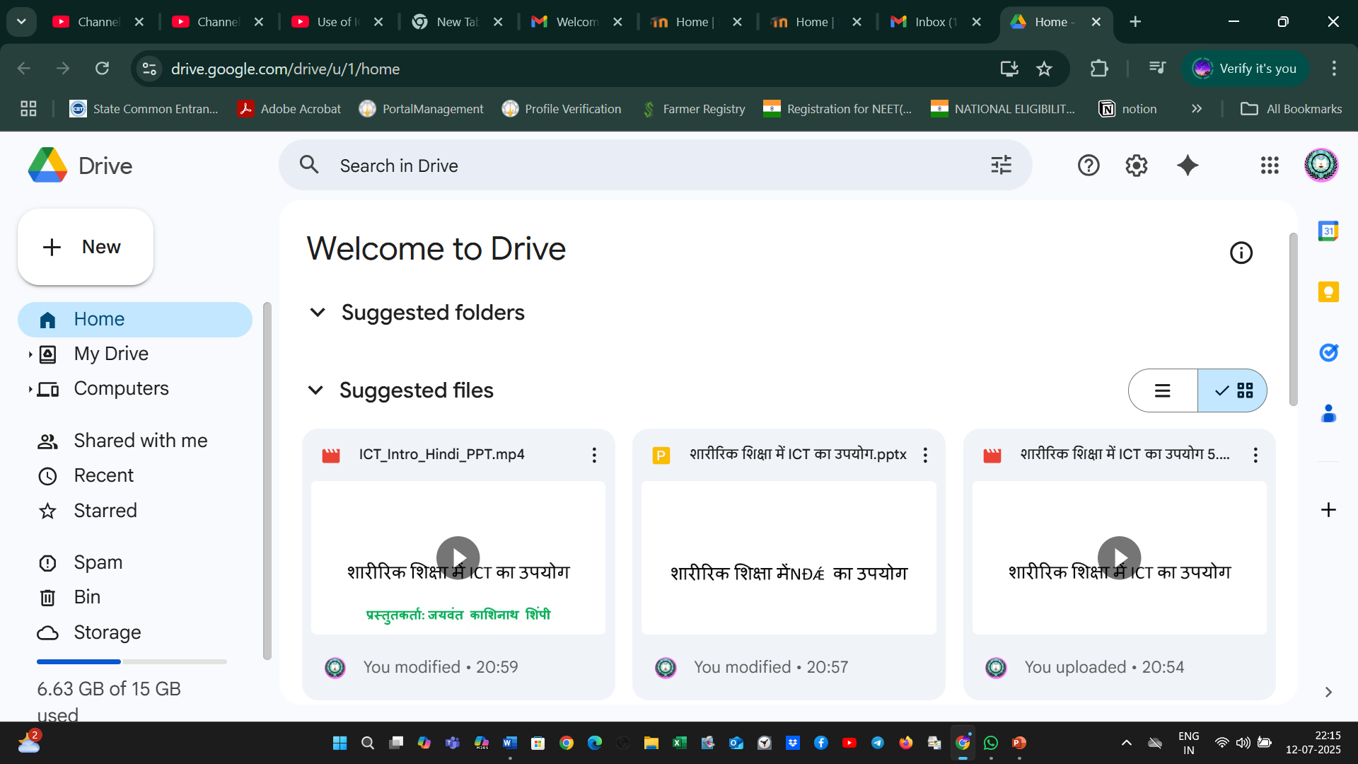
Google drive upload

Slide 6
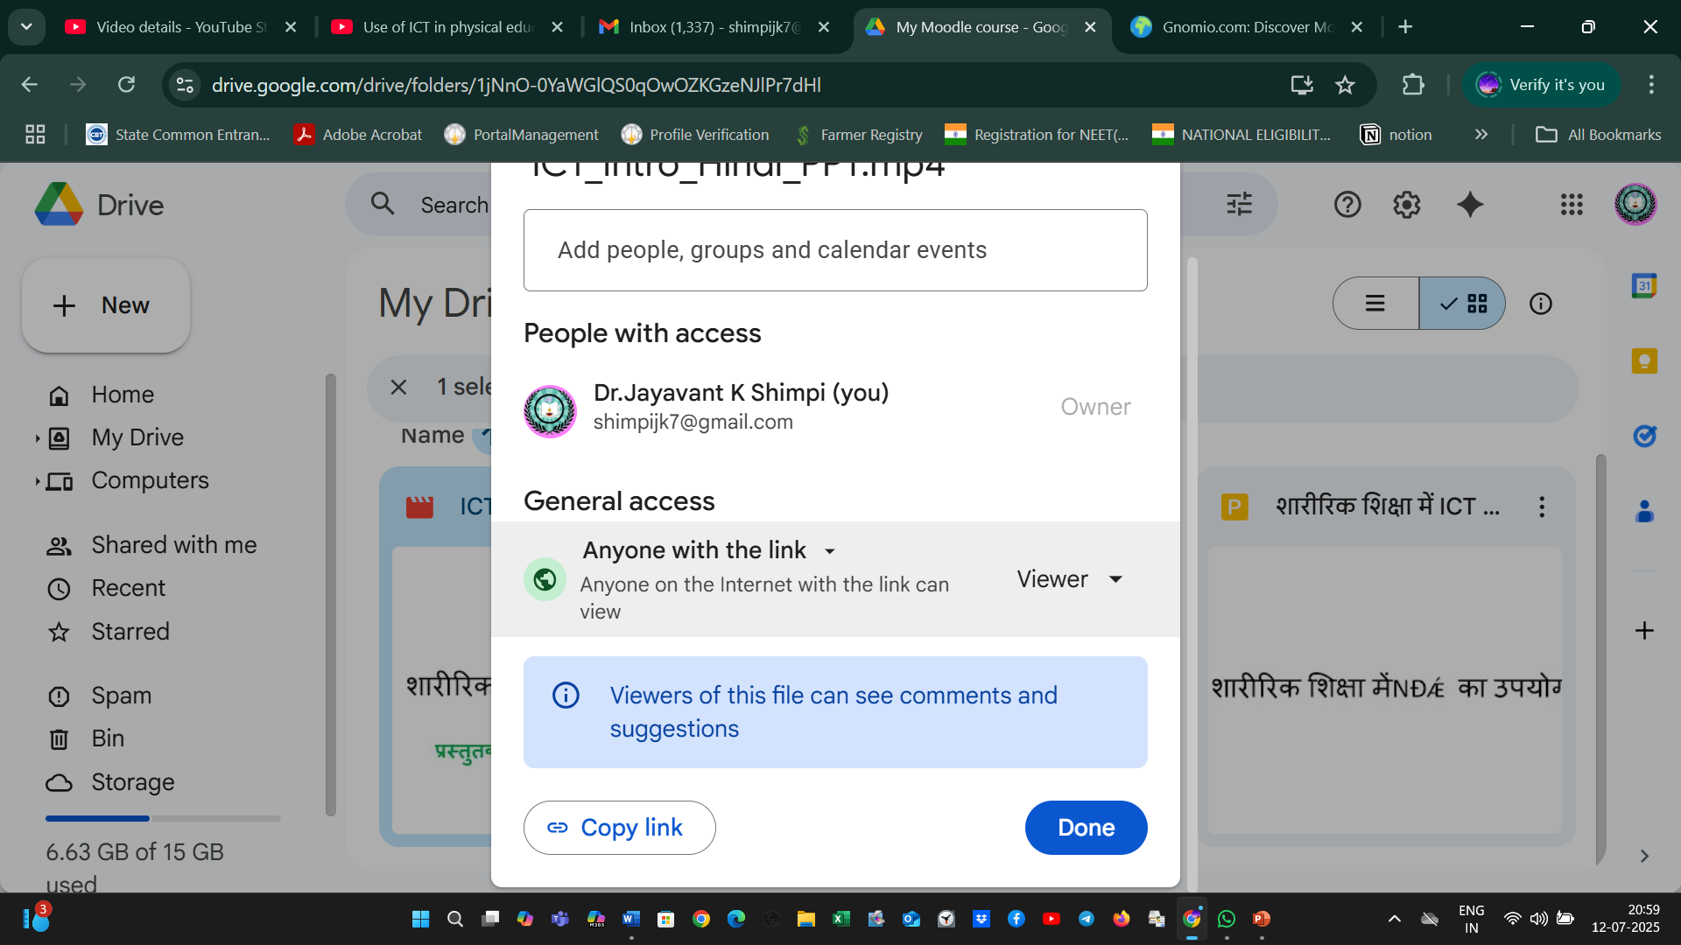
Share setting of drive link

